Slide 1
CSC 370 Project
Sprint 2
May 19th - June 2nd 2024
By Carolina Kierulff & Makayla Savege

Slide 2
Project Overview
We are developing a store management system involving water sport equipment inventory, as well as the records of customers, items, and stores. We will track the purchasing relationship between the customer and the item, and the item stock relationship to the store.

Slide 3
Overview from Sprint
Applied feedback given for ERD
Reworked a few relationship attributes
Added foreign keys to relationships
Generated our dataset in Python
Generated tables for each object and relation in sql
Generated primary key for customer object

Slide 4
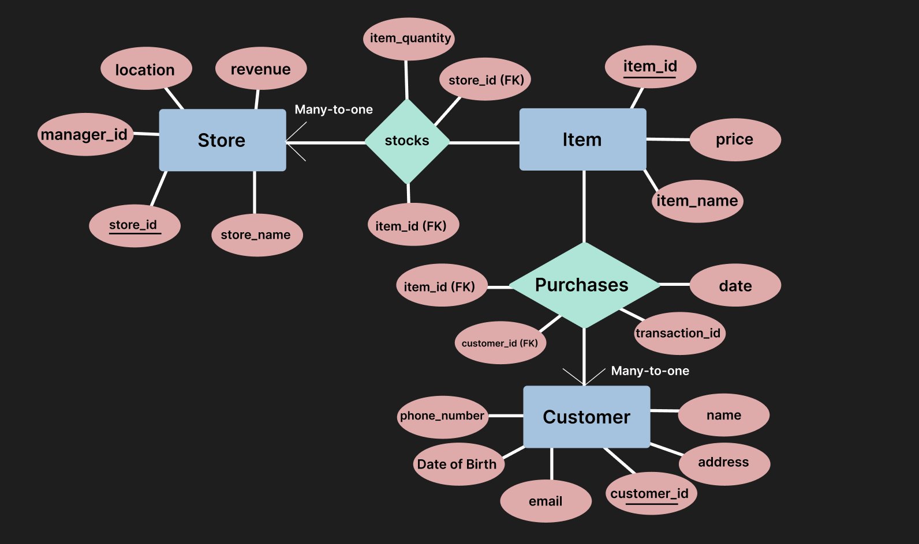
Entity Relationship Diagram

Slide 5
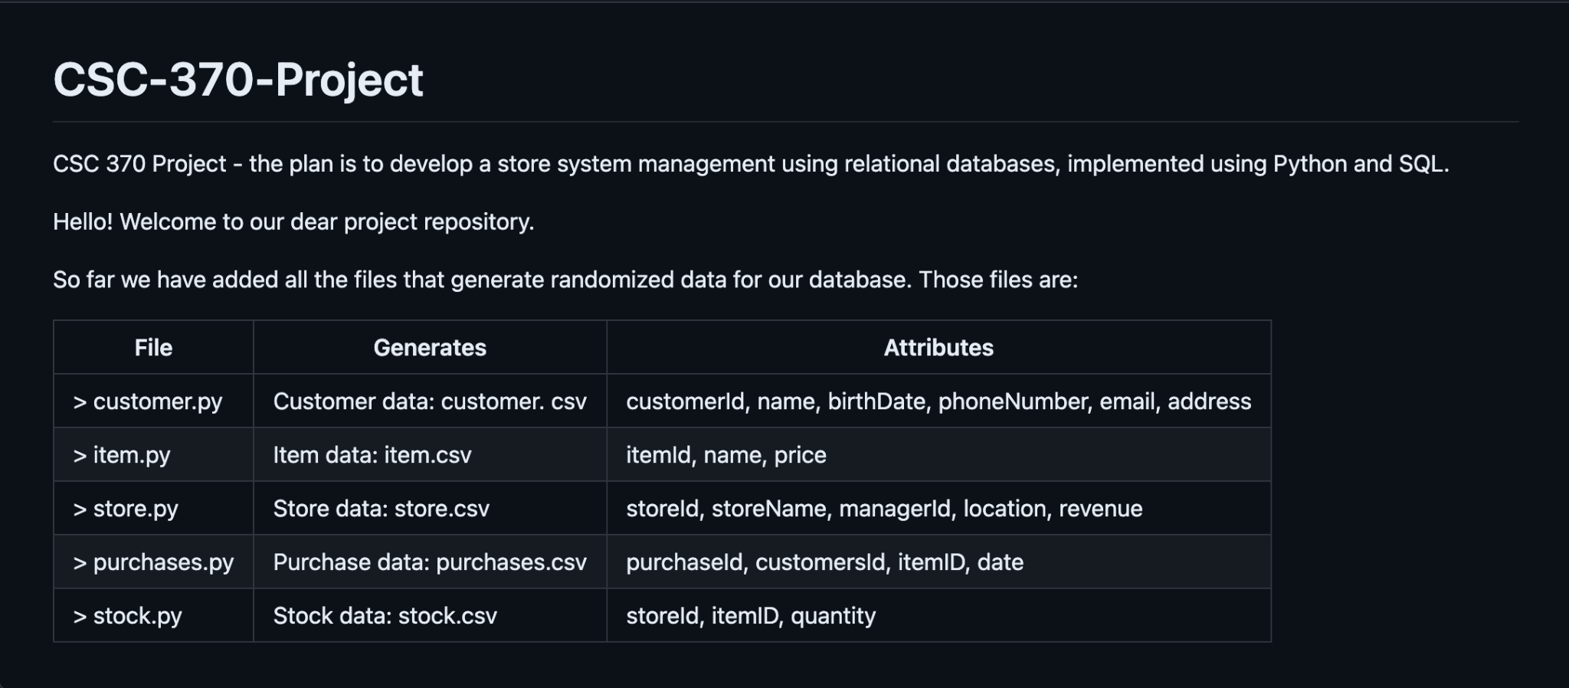
Generated Dataset

Slide 6
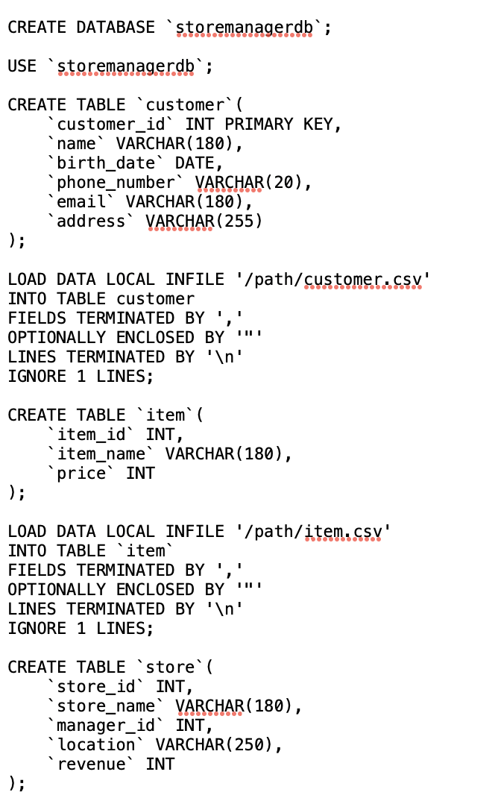
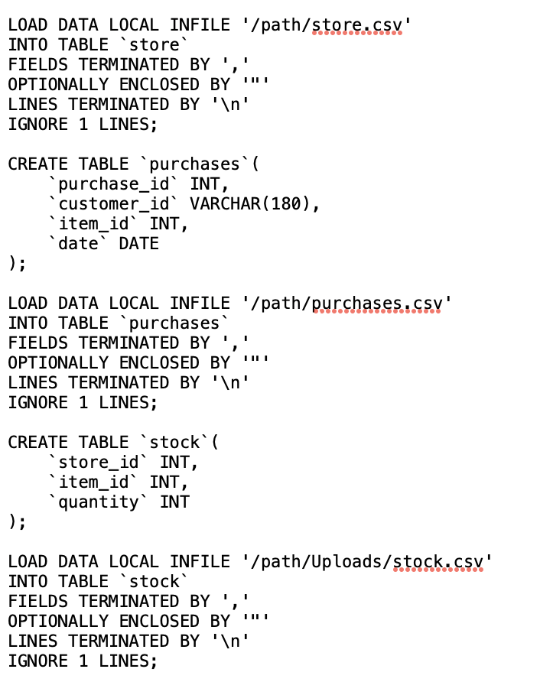
MySQL Queries

Slide 7
Looking ahead
Create more complex queries parallel to content learned in class
I.e. parse through customer data to find who purchases the most items from the chain of stores
Role-Based Access Control: Implement RBAC, define roles and permissions that could be reflected in our ERD
Generate Primary keys for remaining data objects
Generate foreign keys for all data objects and relationships

